Slide 1
Memory Management Disjoint Memory Schemes
Lecture 8 (Live Version)

Slide 2
Overview
Paging Scheme
Basic Idea
Logical Address Translation
Hardware Support
Protection & Page Sharing
Segmentation Scheme
Motivation
Basic Idea
Logical Address Translation
Hardware Support
Segmentation with Paging Scheme

Slide 3
Disjoined Memory Space with Paging
In lecture 7, memory management was discussed with two assumptions:
1. Each process occupies a contiguous memory region
2. The physical memory is large enough to contain one or more processes with complete memory space

Slide 4
Paging Scheme: Basic Idea
The physical memory is split into regions of fixed size (decided by hardware)
known as physical frame
The logical memory of a process is similarly split into regions of same size
known as logical page
At execution time, the pages of a process are loaded into any available memory frame
Logical memory space remain contiguous
Occupied physical memory region can be disjoined!

Slide 5
Page Table: Lookup Mechanism
In contiguous memory allocation, it is very simple to keep track of the usage of a process:
Minimally, starting address and size of process
Under paging scheme:
Logical page ←→ Physical frame mapping is no longer straightforward
Need a lookup table to provide the translation
This structure is known as a Page Table

Slide 6
Paging: Illustration
frame 0
Page 0
1
Page 2
Page 1
0
2
Page 0
1
Page 2
3
2
3
4
Page 3
page table
logical memory
5
Page 3
6
frame 7
Page 1
Page Size = 1,000
load 2357
load 123
physical memory

Slide 7
Logical Address Translation
frame 0
Page 0
1
Page 2
Page 1
2
Page 0
0
2
Page 2
3
1
7
Page 3
2
1
4
3
5
logical memory
5
Page 3
page table
6
frame 7
Page 1
Physical Address
= F x size of physical frame + Offset
physical memory

Slide 8
Logical Address Translation: Essential Tricks
Two important design decisions
Keep frame size (page size) as a power-of-2
Physical frame size == Logical page size
PA = F x size of physical frame + Offset
Page Number
Offset
Logical Address
p
d
(m – n) bits
n bits
Translation mechanism
Physical Address
f
d
Frame Number
Offset

Slide 9
Logical Address Translation: Formula
Given:
Page/Frame size of 2^{n}
m bits of logical address
Logical Address LA:
p = Most significant m-n bits of LA
d = Remaining n bits of LA
Use p to find frame number f
from mapping mechanism like page table
Physical Address PA:
PA = f*2^{n} + d

Slide 10
Example: 4 Logical Pages, 8 Physical Frames
m = 4 bits
...
00000
0000
0001
0010
0011
a
b
c
d
...
00100
page size = 4 bytes
a
b
c
d
01000
01001
01010
01011
.
.
.
.
.
.
.
.
...
01100
00
0
010
1000
1001
1010
1011
i
j
k
l
...
10000
01
1
111
10
m
n
o
p
2
001
10100
10101
10110
10111
11
1100
1101
1110
1111
m
n
o
p
3
101
page table
page table
...
11000
logical address
logical memory
...
11100
physical memory
physical address

Slide 11
Paging: Observations
External fragmentation?
Internal fragmentation?
Clear separation of logical and physical address space
Allow great flexibility
Simple address translation

Slide 12
Implementing Paging Scheme
Common pure-software solution:
OS stores page table information in PCB
Improved understanding: Memory context of a process == Page table
Issues:
Require two memory access for every memory reference

Slide 13
Paging Scheme: Hardware Support
Modern processors provide Translation Look-Aside Buffer (TLB)
TLB acts as a cache of a few page table entries
Logical address translation with TLB:
Use page number to search TLB associatively
Entry found (TLB-Hit):
Frame number is retrieved to generate physical address
Entry not found (TLB-Miss):
Memory access to access the full page table
Retrieved frame number is used to generate physical address and update TLB

Slide 14
Translation Look-Aside Buffer
Physical Memory
CPU
P
D
F
D
Page#
Frame #
TLB
P
Frame #
Page Table

Slide 15
TLB: Impact on Memory Access Time
Suppose:
TLB access takes 1ns
Main memory access takes 50ns
What is the average memory access time if TLB contains 40% of the whole page table?
Memory access time
= TLB hit + TLB miss
= 40% x (1ns + 50ns) + 60%(1ns + 50ns + 50ns)
= 81ns

Slide 16
TLB and Process Switching
Improved Understanding: TLB is part of the hardware context of a process
When a context switch occurs:
TLB entries are flushed
So that new process will not get incorrect translation
Hence, when a process resume running:
Will encounter many TLB misses to fill the TLB
It is possible to place some entries initially
Physical Memory
CPU
P
D
F
D
Page#
Frame #
TLB
P
Frame #
Page Table

Slide 17
Paging Scheme: Protection
To provide memory protection:
Access-Right Bits
Valid Bit
Access Right Bits:
Each Page Table Entry has { writable, readable, executable } bits
Memory access is checked against the access right bits

Slide 18
Paging Scheme: Protection (cont)
Observation:
The logical memory range is usually the same for all processes
However, not all process utilized the whole range
Some pages are out-of-range for a particular process
Valid bit:
Indicate whether the page is valid to access
OS will set the valid bits when a process is running
Memory access is checked against this bit:
Out-of-range access will be caught by OS

Slide 19
Paging Scheme: Page sharing
Page table can allow several processes to share the same physical memory frame
Use the same physical frame number in the page table entries
Possible usage:
Shared code page:
Some code are being used by many processes, e.g. C standard library, system calls etc
Implement Copy-On-Write:
As discussed earlier in "Process Abstraction" lecture, parent and child process can share a page until one tries to change a value in it

Slide 20
Paging Scheme: Page Sharing
Page 0
frame 0
Page 1
0
2
Page 1
1
7
1
Page 2
Page 2
2
1
2
Page 0
Page 3
3
5
Process P's
logical memory
Process P's
page table
3
Page 2
4
Page 0
Page 0
0
5
Page 3
Page 1
1
6
Page 3
Page 2
2
Page 3
3
frame 7
Page 1
Process Q's
logical memory
Process Q's
page table
physical memory
Notes:
Page table can allow several processes to share the same physical memory frame
Use the same physical frame number in the page table entries
Possible usage:
Shared code page:
Some code are being used by many processes, e.g. C standard library, system calls etc
Implement Copy-On-Write:
As discussed in "Process Abstraction", parent and child process can share a page until one tries to update a value in it

Slide 21
Paging Scheme: Copy-On-Write
Page 0
frame 0
Page 1
0
2
Page 1
1
7
1
Page 2
Page 2
2
1
2
Page 0
Page 3
3
5
Process P's
page table
Page 2
Process P's
logical memory
3
Page 2
4
Page 0
Page 0
5
Page 3
Page 1
0
1
6
Page 3
Page 2
2
Page 3
frame 7
Page 1
3
Process Q's
logical memory
physical memory
Process Q's
page table
Notes:
Page table can allow several processes to share the same physical memory frame
Use the same physical frame number in the page table entries
Possible usage:
Shared code page:
Some code are being used by many processes, e.g. C standard library, system calls etc
Implement Copy-On-Write:
As discussed in "Process Abstraction", parent and child process can share a page until one tries to update a value in it

Slide 22
Segmentation Scheme

Slide 23
Segmentation Scheme: Motivation
The memory space of a process is treated as a single entity so far
However, there are a number of memory regions with different usage in a process
Text
Logical
Memory
Space
Text
Data
Data
Heap
Heap
Stack
Stack

Slide 24
Segmentation Scheme: Motivation (cont)
Some regions may grow / shrink at execution time
Notes:
It is hard to place different regions in a contiguous memory space and still allow them grow/shrink freely
Also hard to check whether a memory access in a region is in-range or not

Slide 25
Segmentation Scheme: Basic Idea
Separate the regions into multiple memory segments
Logical memory space of a process is now a collection of segments
Each memory segment:
Has a name
Has a limit
All memory reference is now specified as:
Segment name + Offset
Heap Segment
+245
Item
Memory Access:
"Heap" + 245

Slide 26
Segmentation: Illustration
Global Data Segment
Stack Segment
Global Data Segment
User Code Segment
User Code Segment
Heap Segment
Heap Segment
Stack Segment
Logical Address Space
(Segments can be of different sizes)
Physical Memory
(Segments are disjointed in RAM)

Slide 27
Segmentation: Logical Address Translation
Each segment is mapped to a contiguous physical memory region
with a base address and a limit
The segmentation name is usually represented as a single number
Known as segment id
Logical address <SegID, Offset>:
SegID is used to look up <Base, Limit> of the segment in a segment table
Physical Address PA = Base + Offset
Offset < Limit for valid access

Slide 28
Logical Address Translation: Illustration
Assume: User Code Segment = 0 Global Data Segment = 1 Heap Segment = 2 Stack Segment = 3
7500
Global Data Segment
6000
Memory Access
< Segment Id, Offset >
5700
User Code Segment
Base
Base
Limit
Limit
0
0
3500
2200
3500
Heap Segment
1
2900
1
6000
1500
2
2
2400
1100
2400
3
3
0
1300
1300
Stack Segment
segment table
segment table
< 2, 500 >
< 1, 1600 >
0
Physical Memory
Notes:
UPDATE: Reverse the memory range?

Slide 29
Segmentation: Hardware Support
S
Limit
Base
Physical Memory
Segment Table
<
Yes
+
CPU
No
S
D
Addressing Error!

Slide 30
Segmentation: Summary
Pros:
Each segment is an independent contiguous memory space
➔ Can grow / shrink independently
➔ Can be protected / shared independently
Cons:
Segmentation requires variable-size contiguous memory regions
➔ can cause external fragmentation
Important observation:
Segmentation is not the same as paging
Each of them trying to solve a different problem

Slide 31
Segmentation with paging

Slide 32
Segmentation with Paging: Basic Idea
Logical Address Space
GD P#3
Stack Segment
Global Data Segment
User Code Segment
GD P#1
GD P#0
Heap Segment
0
1
0
2
0
0
1
3
1
1
2
2
2
3
GD P#2
User Code
page table
3
3
Global Data
page table
Physical Memory
Heap
page table
Stack
page table
Notes:
Basic Idea:
Each segment is now composed of several pages instead of a contiguous memory region
Essentially, each segment has a page table
Segment can grows by allocating new page then add to its page table and similarly for shrinking

Slide 33
Segmentation with Paging: Illustration
S
Page limit
Pg Table Base
Physical Memory
Segment Table
P
<
Yes
Frame Number
No
Addressing Error!
Page Table
CPU
S
P
D
F
D

Slide 34
Segmentation with Paging
frame 0
1
< 1, 6 >
0
7
2
Process P
3
1
2
Text(0)
2
14
4
Page 0
5
Page 1
6
0
3
...
0
9
Page 2
7
1
2
...
1
13
8
2
1
...
Data(1)
9
Page 0
3
1
...
Stck(2)
10
Page 1
Page 0
0
12
11
12
Heap(3)
13
Page 0
0
6
14
4-byte Page
frame 15
Notes:
Possible usage:
Shared code page:
Some code are being used by many processes, e.g. C standard library, system calls etc
Implement Copy-On-Write:
As discussed in "Process Abstraction", parent and child process can share a page until one tries to update a value in it

Slide 35
Summary
Discussed two popular memory management schemes
Both allow the logical address space to be in dis-joined physical region
Paging split the logical address into fixed size pages
Store in fixed size physical memory frames
Segmentation split the logical address into variable size segments according to their usage
Stored in variable-sized physical partitions

Slide 36
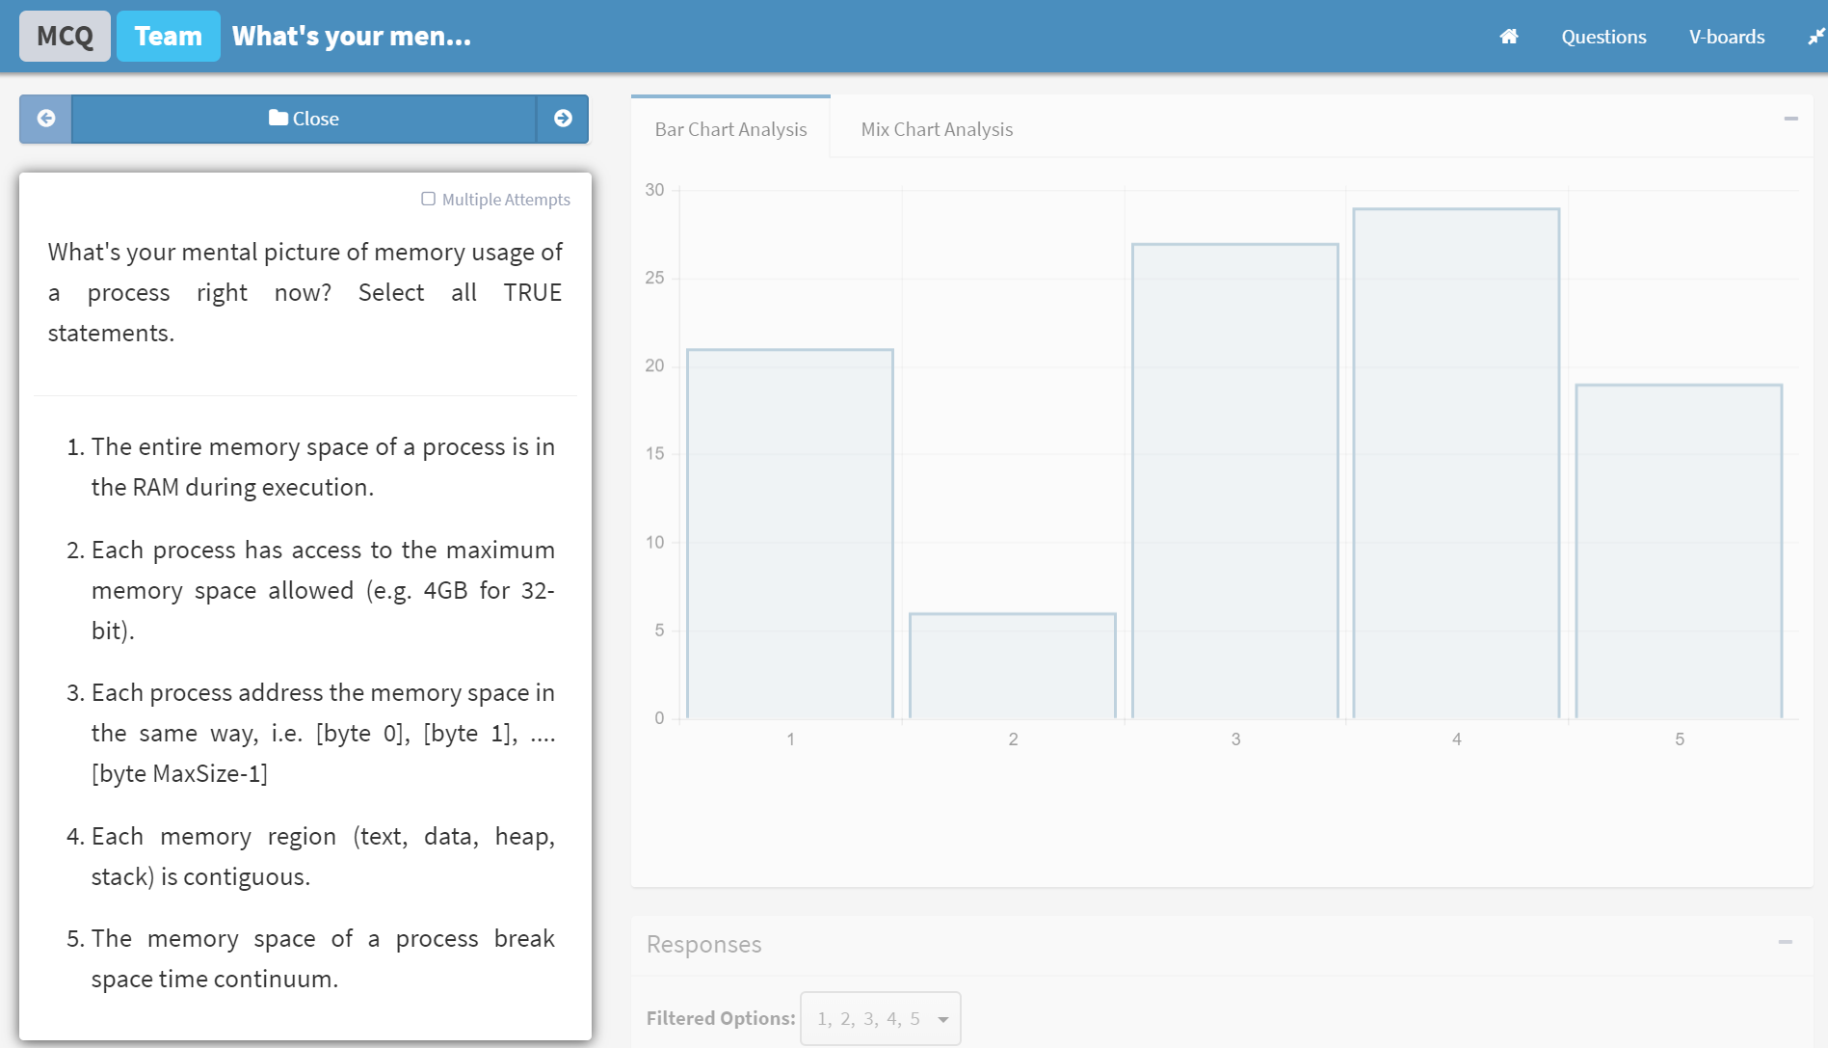
Memory Usage: Mental Picture
E

